Slide 1
Using Improv in Your Class
(Without going to 2nd City)
Timothy D. West
Grant Thornton Professor of Accounting
Northern Illinois University

Slide 2

Nobody knows what it’s like to be the sad man …
Behind Blue Eyes ~ The Who
2009

Slide 3
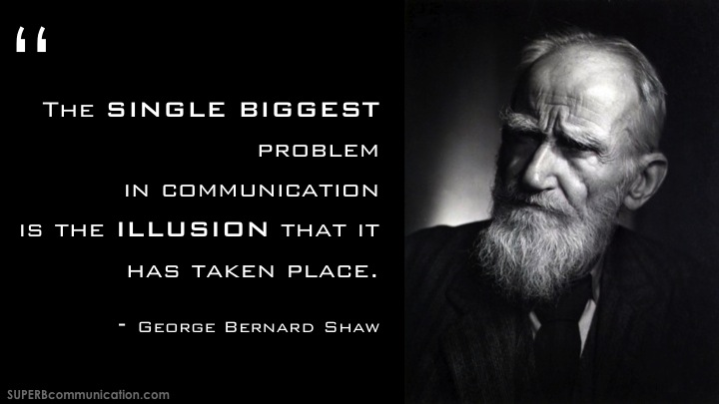

Slide 4
ENGAGEMENT

Slide 5
Battle Rhythm of Education
(My Comfort Zone)

Slide 6
Accounting Students
(What are this?)

Slide 7

Students Expected:
Subject-Driven Course Design
Are we still great and powerful?

Slide 8
The Goal of Education is …
… to enable students to understand the world around them and the talents within them so they can become fulfilled individuals and active, compassionate citizens.
Creative Schools (2015, xxiv)
Sir Kenneth Robinson with Lou Aronica
Notes:
Four basic purposes of education:
Personal
Cultural
Social
Economic

Slide 9
Deloitte Alumni Newsletter 2014

Slide 10
The Second City & NIU
2010
665
21

Slide 11

Ensemble-Driven Course Design

Slide 12
Achievement = Skill × Effort
Skill: (1) Intellectual Speed, (2) Executive function (creativity), and (3) Rate of Learning
Effort (Time spent on task):
Self-discipline (VIA), (2) GRIT, (3) Mindset, or
(4) Conscientiousness (Big 5)
Seligman, M. 2011. Flourish
Duckworth, A. and Seligman, M. 2005. Self-Discipline outdoes IQ … Psychological Science 16 (12): 939-944

Slide 13

1. Co-Create & 2. Ensemble
6. Listen
3. Yes-And
5. Failure
4. Authentic

Slide 14
The Second City
Core Beliefs:
Trust your instincts
Reserve judgment (of yourself and others)
Support ideas and effort
Remember:
Be aware of your tendencies
Practice being “others’ focused”
Step outside your Comfort Zone

Slide 15
You Never Even Called Me by My Name
David Allen Coe
SNAP INTRODUCTIONS
(Groups of 8, or so)

Slide 16
Simply the Best, Better than all the Rest
Tina Turner
Let’s play
Rock Paper, Scissors
Do you create a supportive classroom environment?
Create FOUR Quadrants in the room

Slide 17

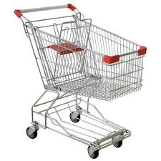
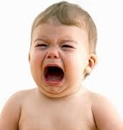




Openness to Ideas
Red Ball Exercise
Everyone form a circle

Slide 18
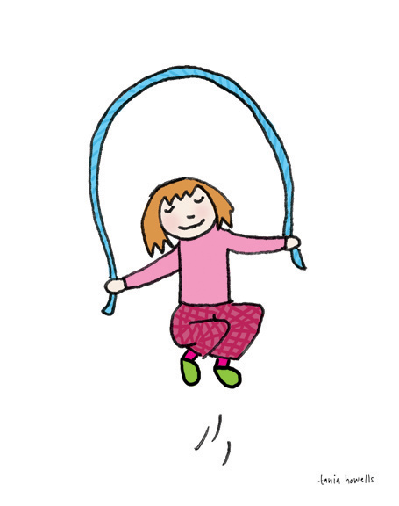
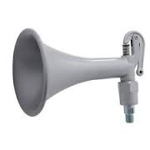


Openness to Ideas
ZOOM
EVERYONE Form a circle
Reverse
Skip
Shift
Dance Party

Slide 19
Classroom Application
Start each class by passing the Zoom (ideas)
Why do company’s allocate cost?
How do you determine target profit?
What does the “death spiral” mean for organizations?

Slide 20

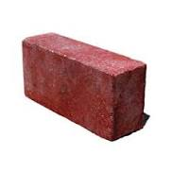
1. Co-Creation
(Circles of 20)
Let’s play Statues
Remember to say thank you – Attitude of Graditude
Bring a
NOT a
Cathedral

Slide 21
1. Co-Create
(Groups of 4)
All of US are smarter than ONE of us!
Let’s play PILLARS
Your idea(s) keep the flow of ideas going

Slide 22
Classroom Application
(Groups of 4)
Build an Operational Story
Class: Provides WHO, WHAT and WHERE
Student 1: Provide a Financial “Fact”
Student 2: Provide a Non-financial “Fact” in support of Student 1
Student 3: Provide a 2nd Financial “Fact,” that ties the first two facts together
Student 4: Identify another piece of information they need for the story.

Slide 23
Team vs. Ensemble
TEAM: Implies competition – People forming one side in a game or contest. Freeloaders reduce accountability!
ENSEMBLE: Implies collaboration – Only exists when the members work as one.
Collaborators increase accountability!
Solo Acts are rarely – in fact – solo!

Slide 24
2. Ensemble
(Groups of 6)
Let’s play STRING OF PEARLS
Every idea keeps the flow of ideas going!

Slide 25
Round 1 – Group 1
Students can no longer take the CPA exam while in school
The American Economy collapses

Slide 26
Round 2
All 18 year-olds must complete a Year-of-Service (military, Peace Corps, etc.)
Business fraud virtually eliminated

Slide 27
Round 3
By law, everyone in the U.S. must exercise ONE hour five days a week
The Federal Budget Deficit is eliminated

Slide 28
Classroom Application
Operating leverage is 10
China needs more Budweiser
Can I get a little inductive reasoning up in here!?

Slide 29
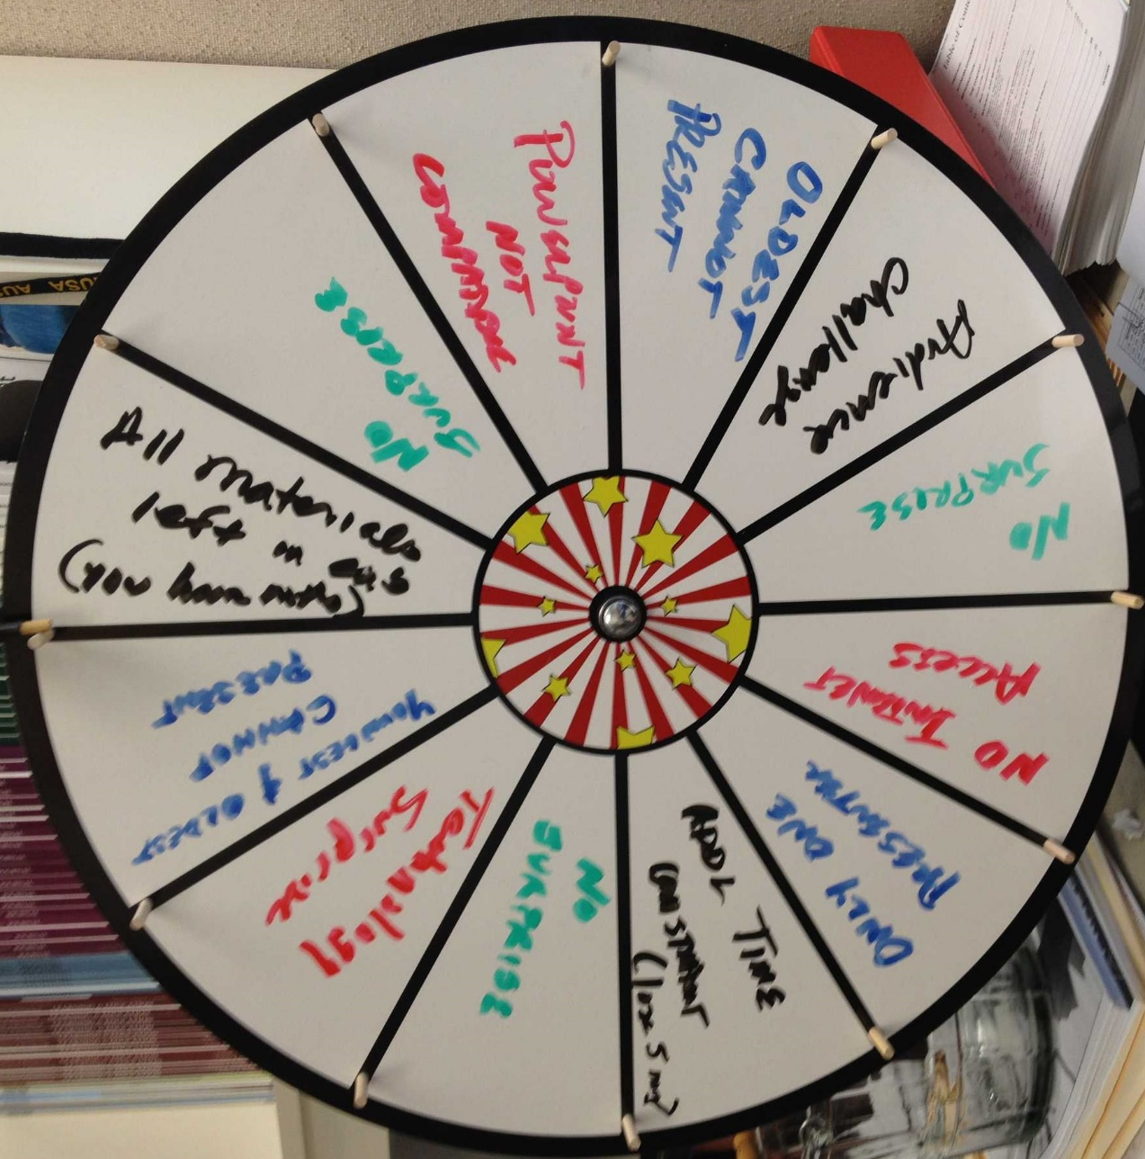
A word about, The Wheel of Doom

Slide 30
2. Yes-And
(Groups of 3)
Plan THE Next:
MAS TEACHING SYMPOSIUM
The More Outrageous the Better
(The ONLY Rule – You have NO Constraints)
YES, And
YES, But
NO
Losada Ratio

Slide 31
Classroom Application
Role play a business meeting!
(Group of 4)
Class: Provides WHO, WHAT AND WHERE
Group: Designate the accountant
Group: Discuss the potential for a new product introduction
Work through the three approaches: NO, YES-BUT and YES-AND

Slide 32
3. Authenticity
(Groups of 3)
Let’s play TAKE THAT BACK
React positively to UNCERTAINTY
Be Grateful for information (Good & Bad)

Slide 33
3. Authenticity
(Be present in the moment)
Let’s play COCKTAIL PARTY
Everyone in the pool!

Slide 34


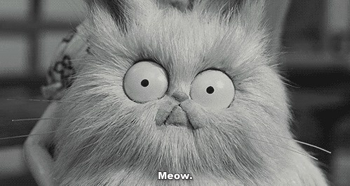
4. Failure
(Groups of 10-12)
Let’s play MISTY VISTAS
Fail Quickly and Move On!
Misty
Vistas
Whiskey
Mixers
Mr. Whiskers

Slide 35
You have my permission to FAIL!

Slide 36

6. Listening: Do we Listen to Respond?
Imagine what others are saying as the length of an arm
When we start tuning out and planning our response!

Slide 37
Or, Listen to Understand
LISTEN TO UNDERSTAND!
(Instead of listening to Respond)
LISTEN FOR INTENT!
(Identify the Emotion)
Half your day is spent listening!
So stay in the moment.

Slide 38
6. Listen
(Groups of 2)
Thank You
How did that change the conversation?
Last Word
How did that change the conversation?

Slide 39
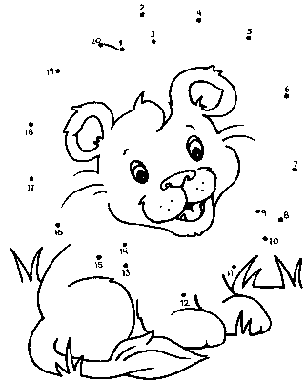

I finally realized – I had ONE talent
184
●
Connect the Dots

Slide 40
Warning!
It is dangerous to make everyone go forward by the same road, and worse to measure others by yourself!
~ Ignatius Loyola

Slide 42
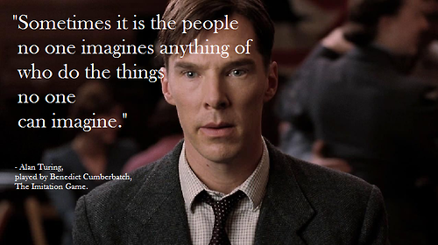

Slide 43
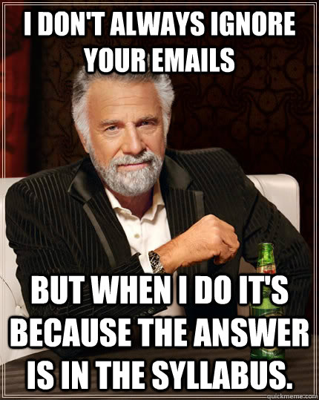

Slide 44
THANKS!
tdwest@niu.edu
twest522@gmail.com
815-753-6252 (office)
314-660-3924 (cell)
314-662-5456 (Susan’s cell)

